Slide 1
Center Selection Problem
Zhiyuan Wang
12032878
Greedy center selection algorithm

Slide 2
Content
Center Selection Problem
Greedy center selection algorithm
The example where the obtained value r(C) equal to 2r(C*) or r(C*)
The algorithm to select the initial center for the greedy center selection

Slide 3

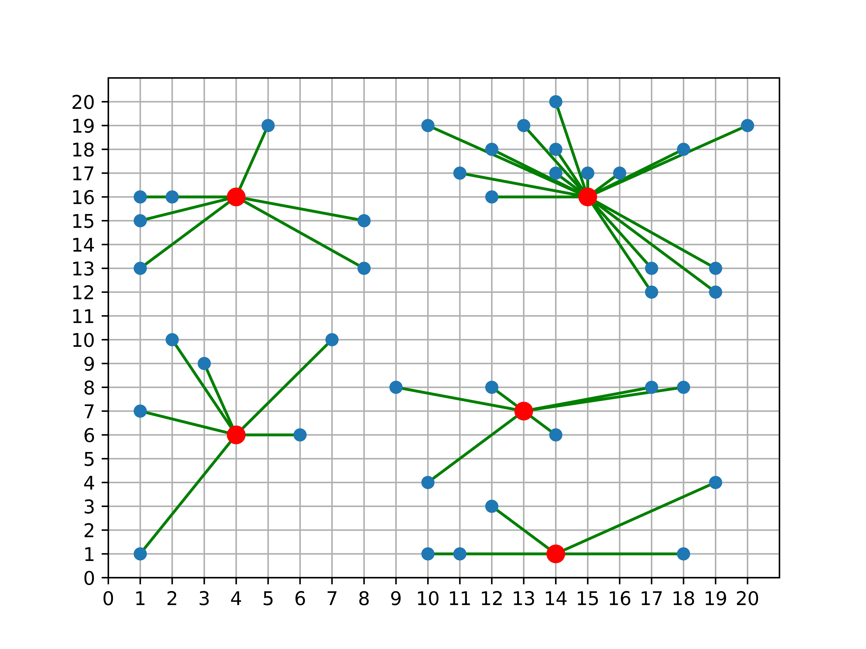
Center Selection Problem
This problem’s objective is to minimize the maximum distance from each site to the nearest center.

Slide 4
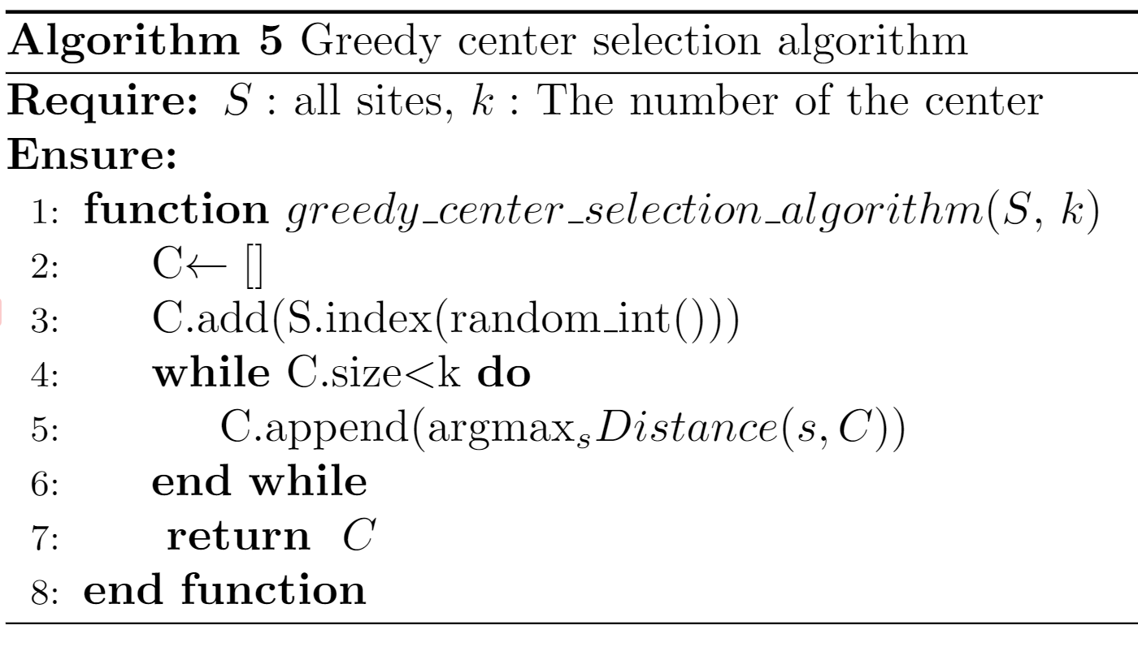
Greedy center selection algorithm
This algorithm use a greedy strategy to choice the sites as the center.
Firstly, it will choice an initial center randomly.
Then, choice the farthest site from the centers as the next center iteratively until we get enough centers.

Slide 5
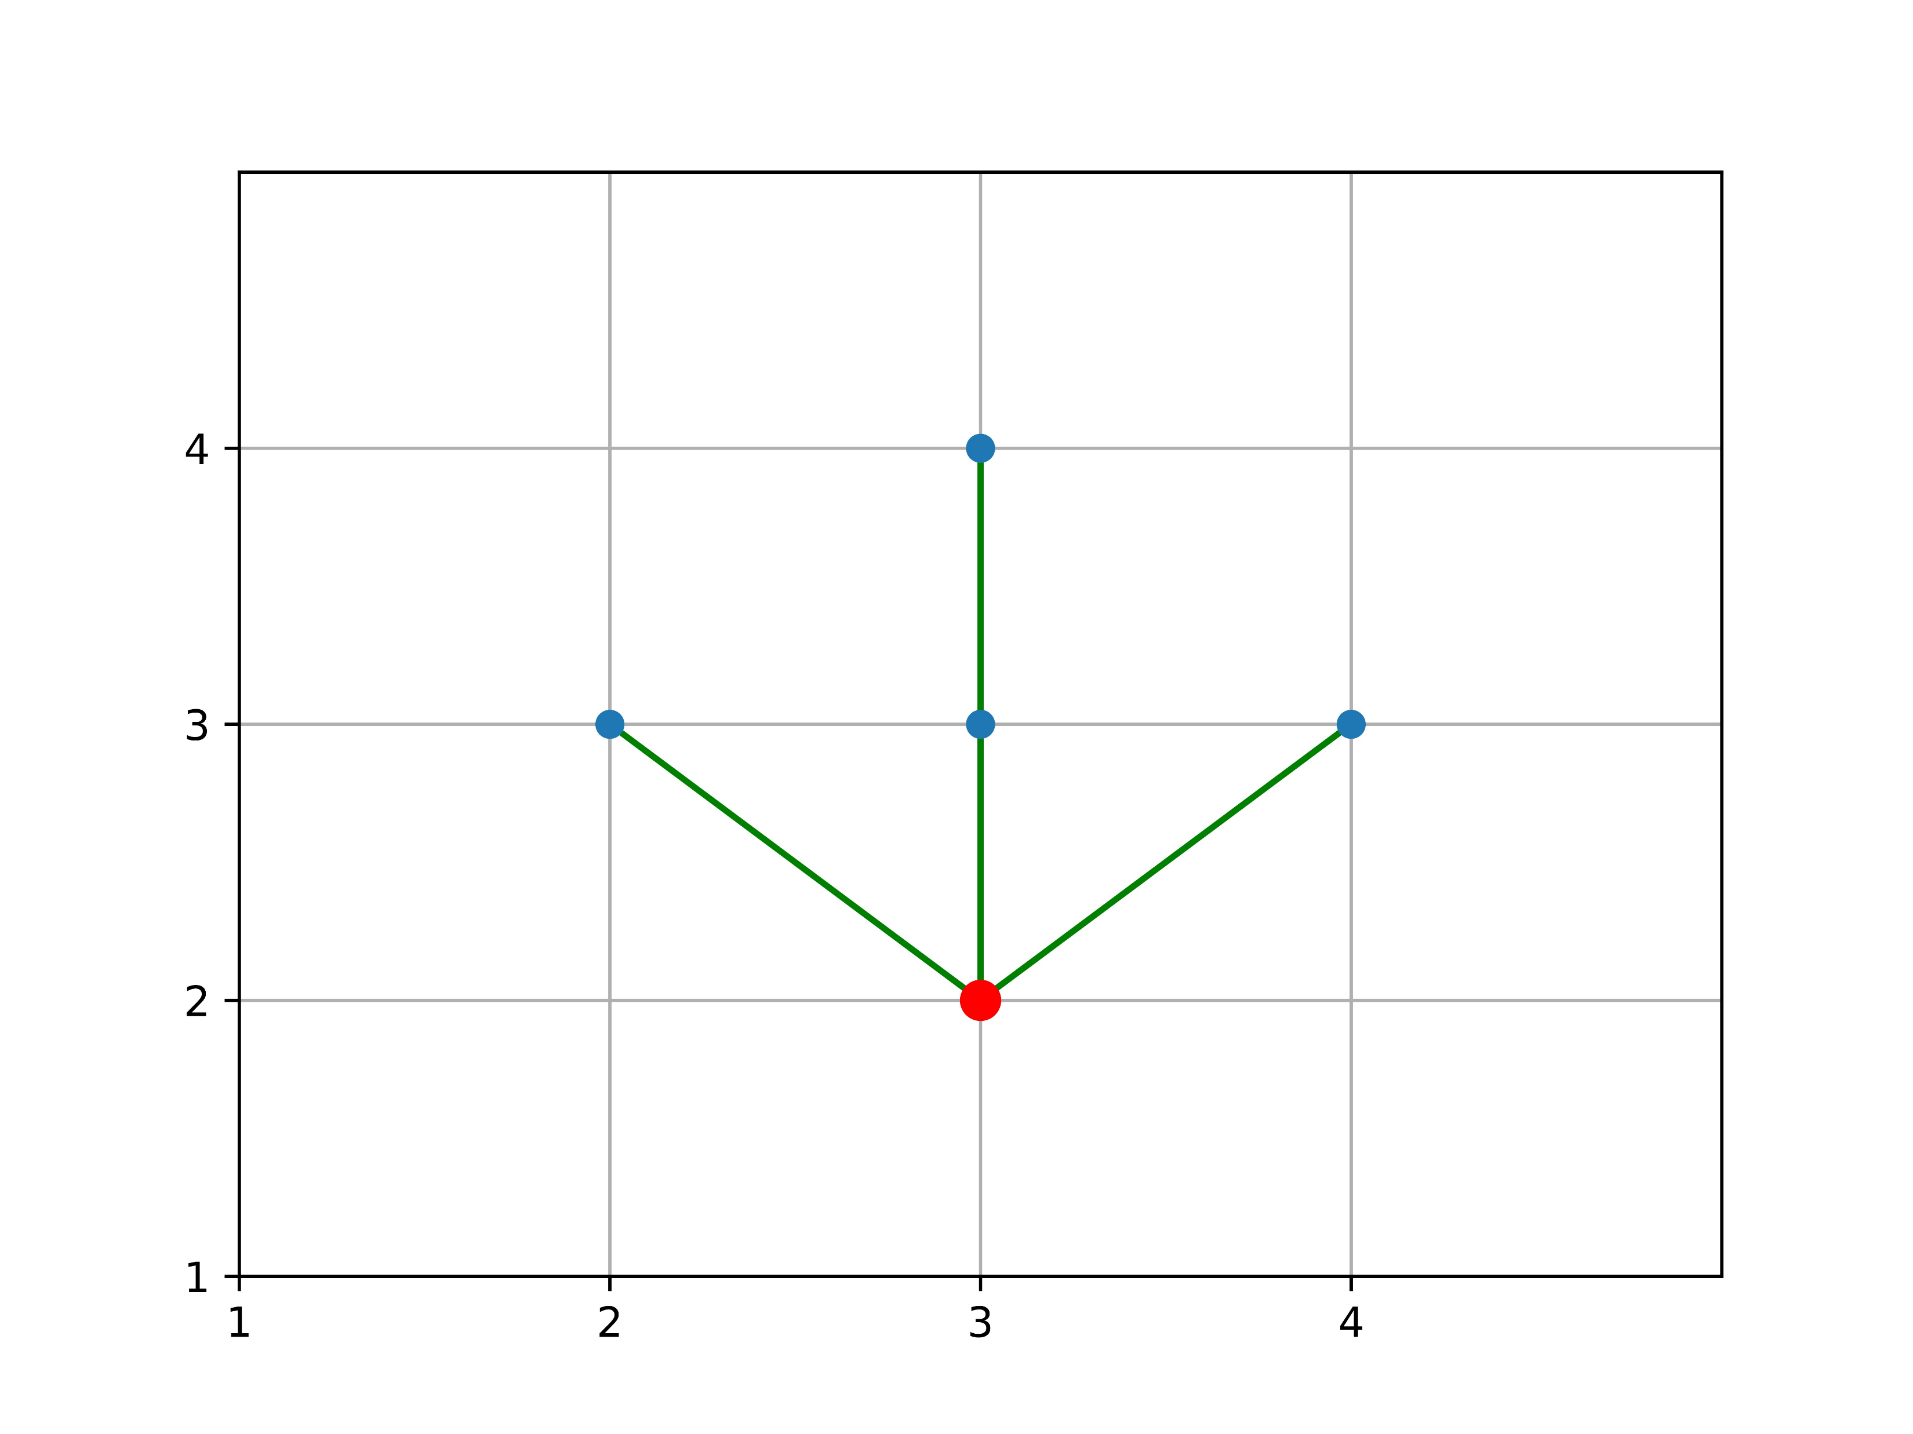
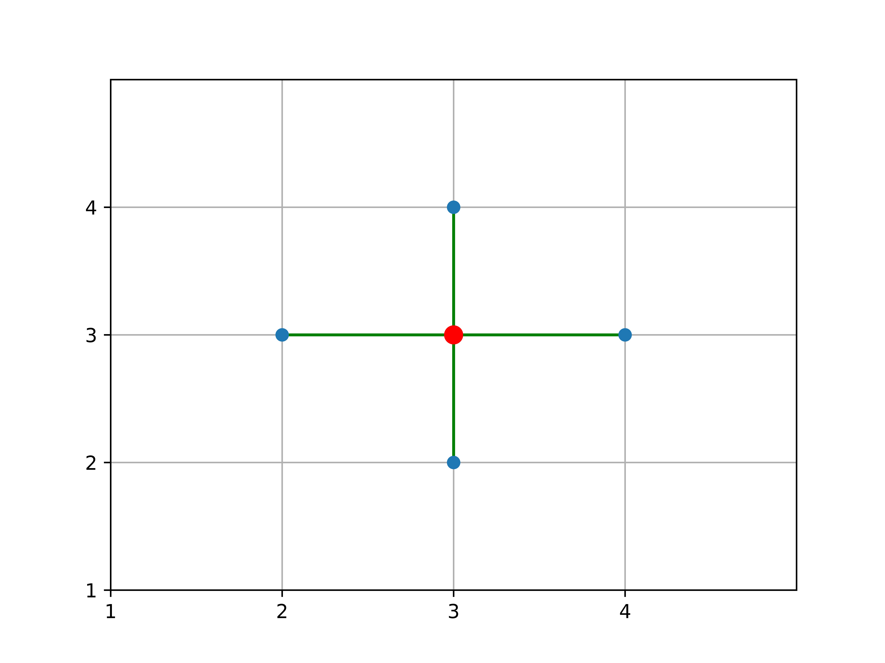
The Example For greedy selection
Choice (3,2) as initial center
Choice (3,3) as initial center

Slide 6
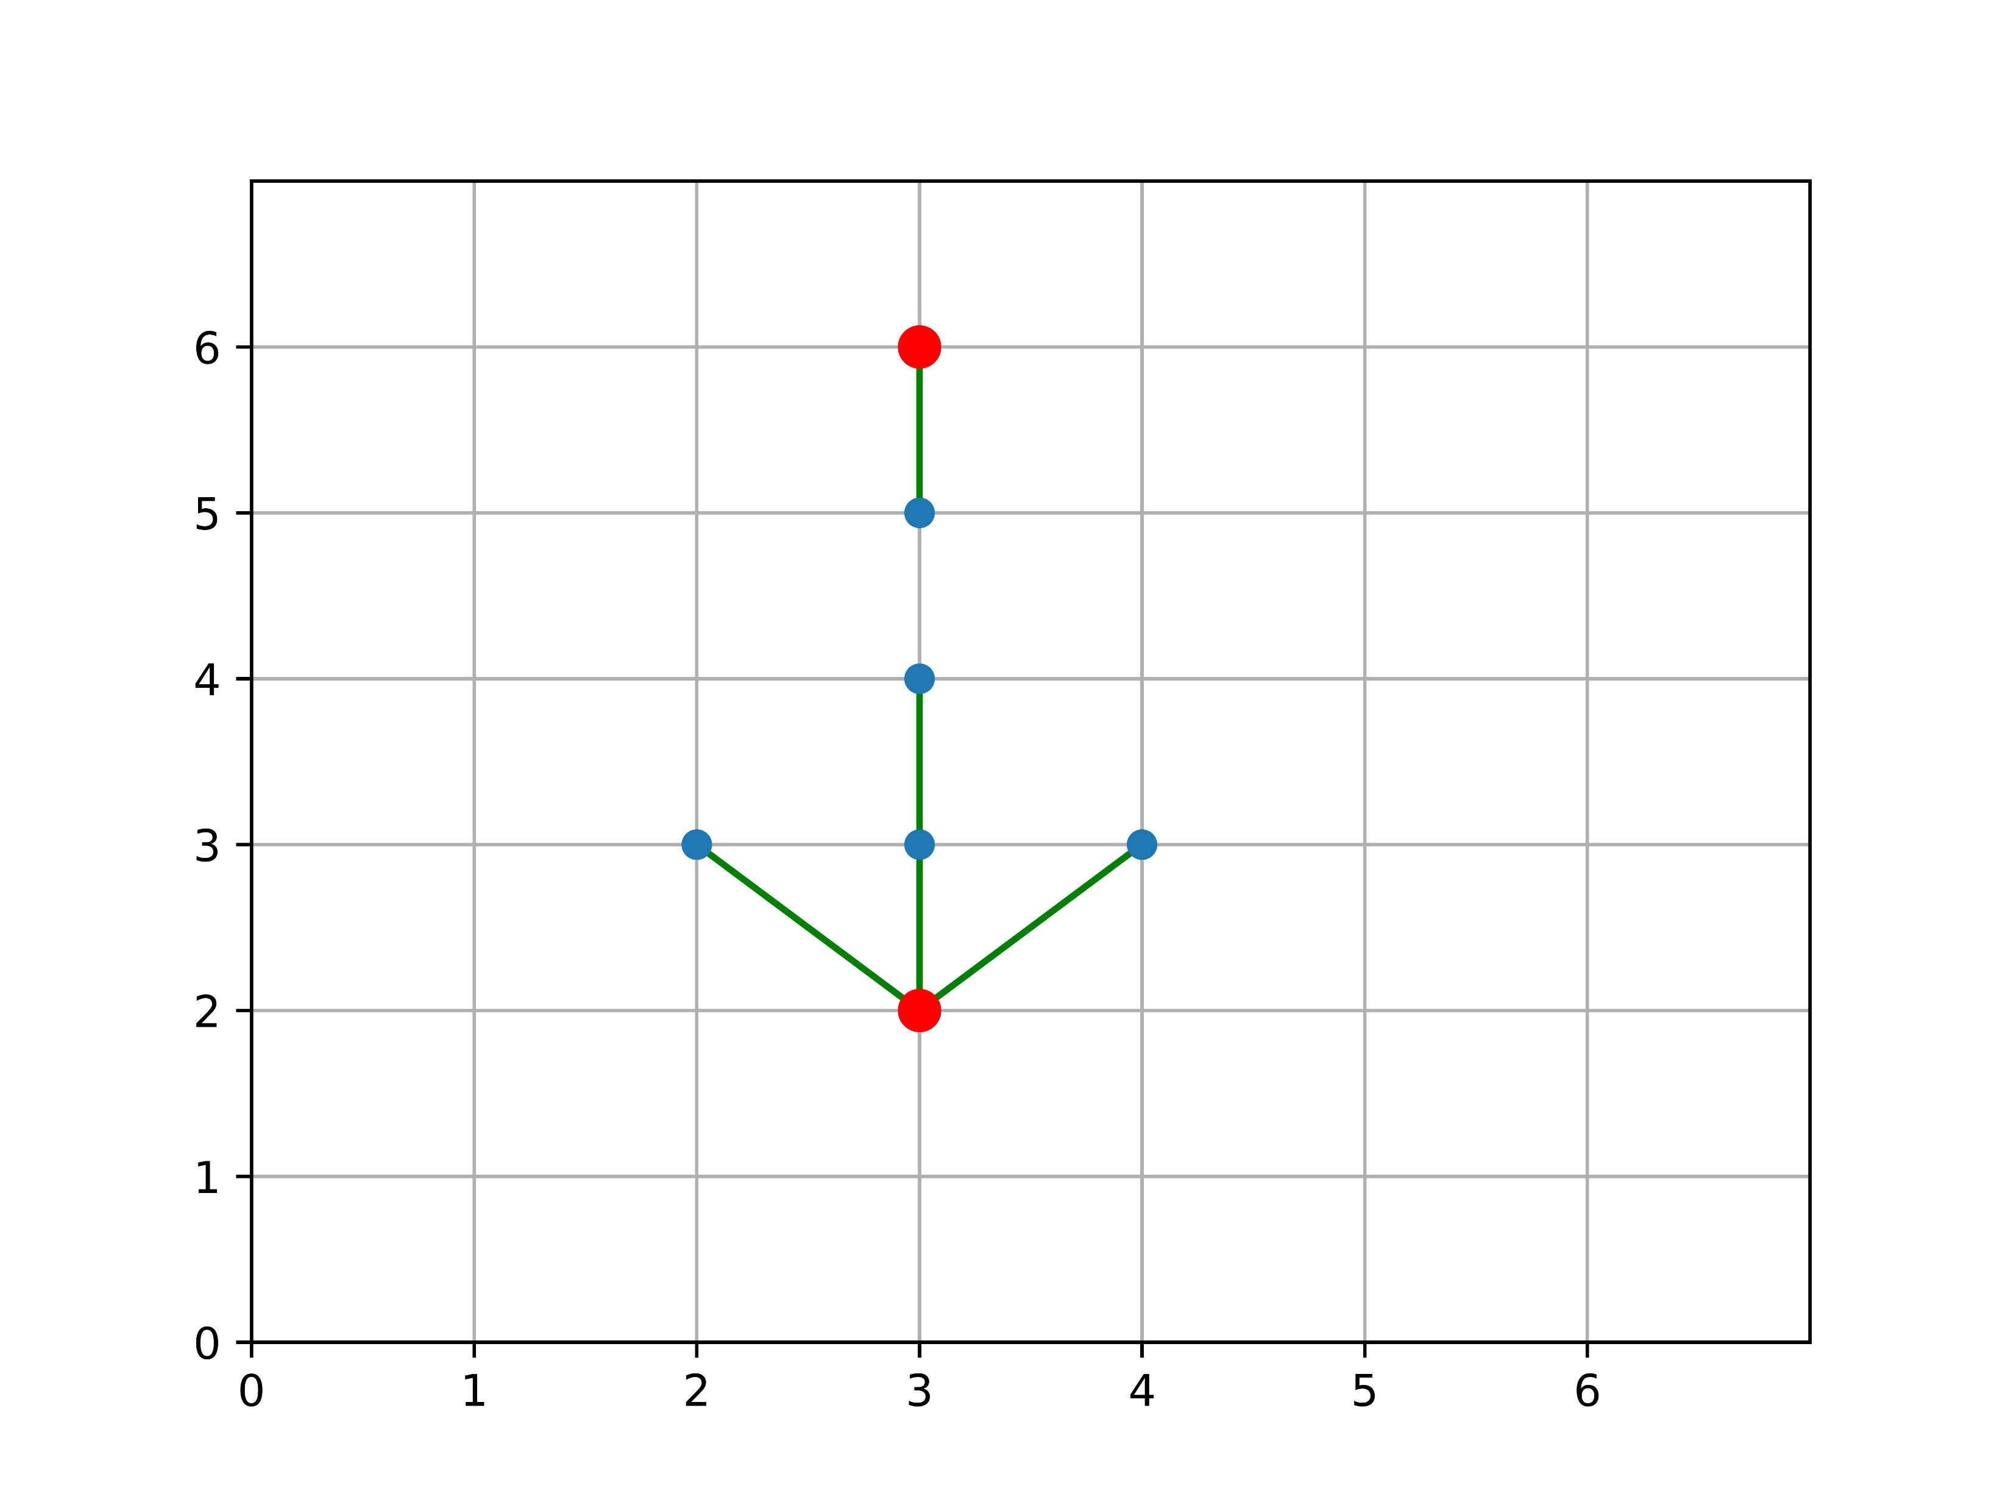
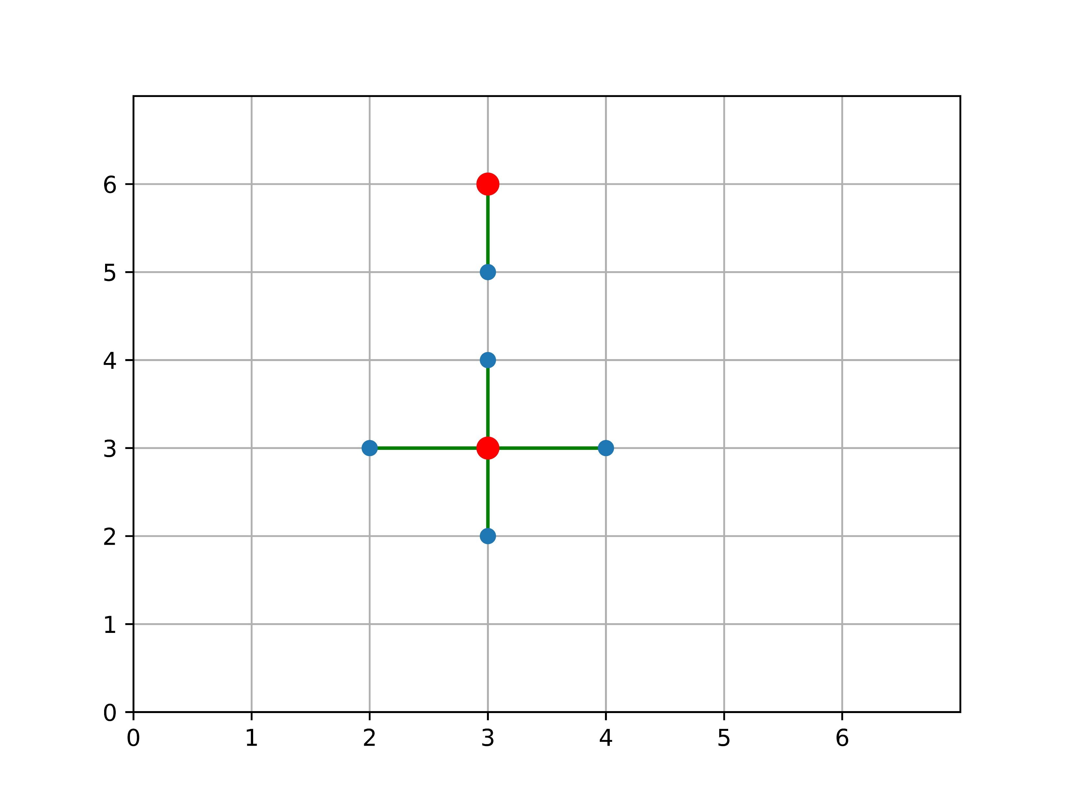
The Example For greedy selection
Choice (3,2) as initial center
r(C) = 2r(C*)
Choice (3,3) as initial center
r(C) = r(C*)

Slide 7
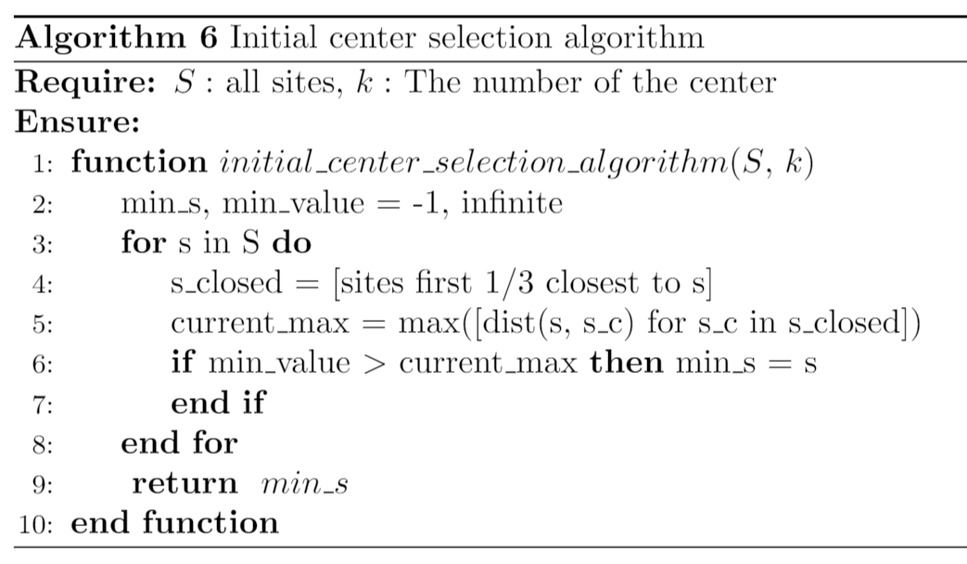
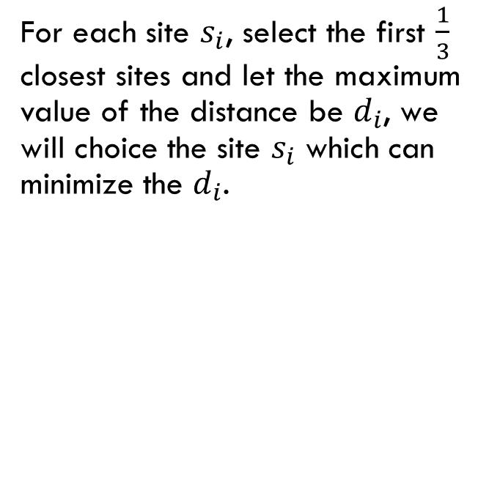
The algorithm to select the initial center for the greedy center selection
For each site $s_{i}$, select the first $\frac{1}{3}$ closest sites and let the maximum value of the distance be $d_{i}$, we will choice the site $s_{i}$ which can minimize the $d_{i}$.

Slide 8
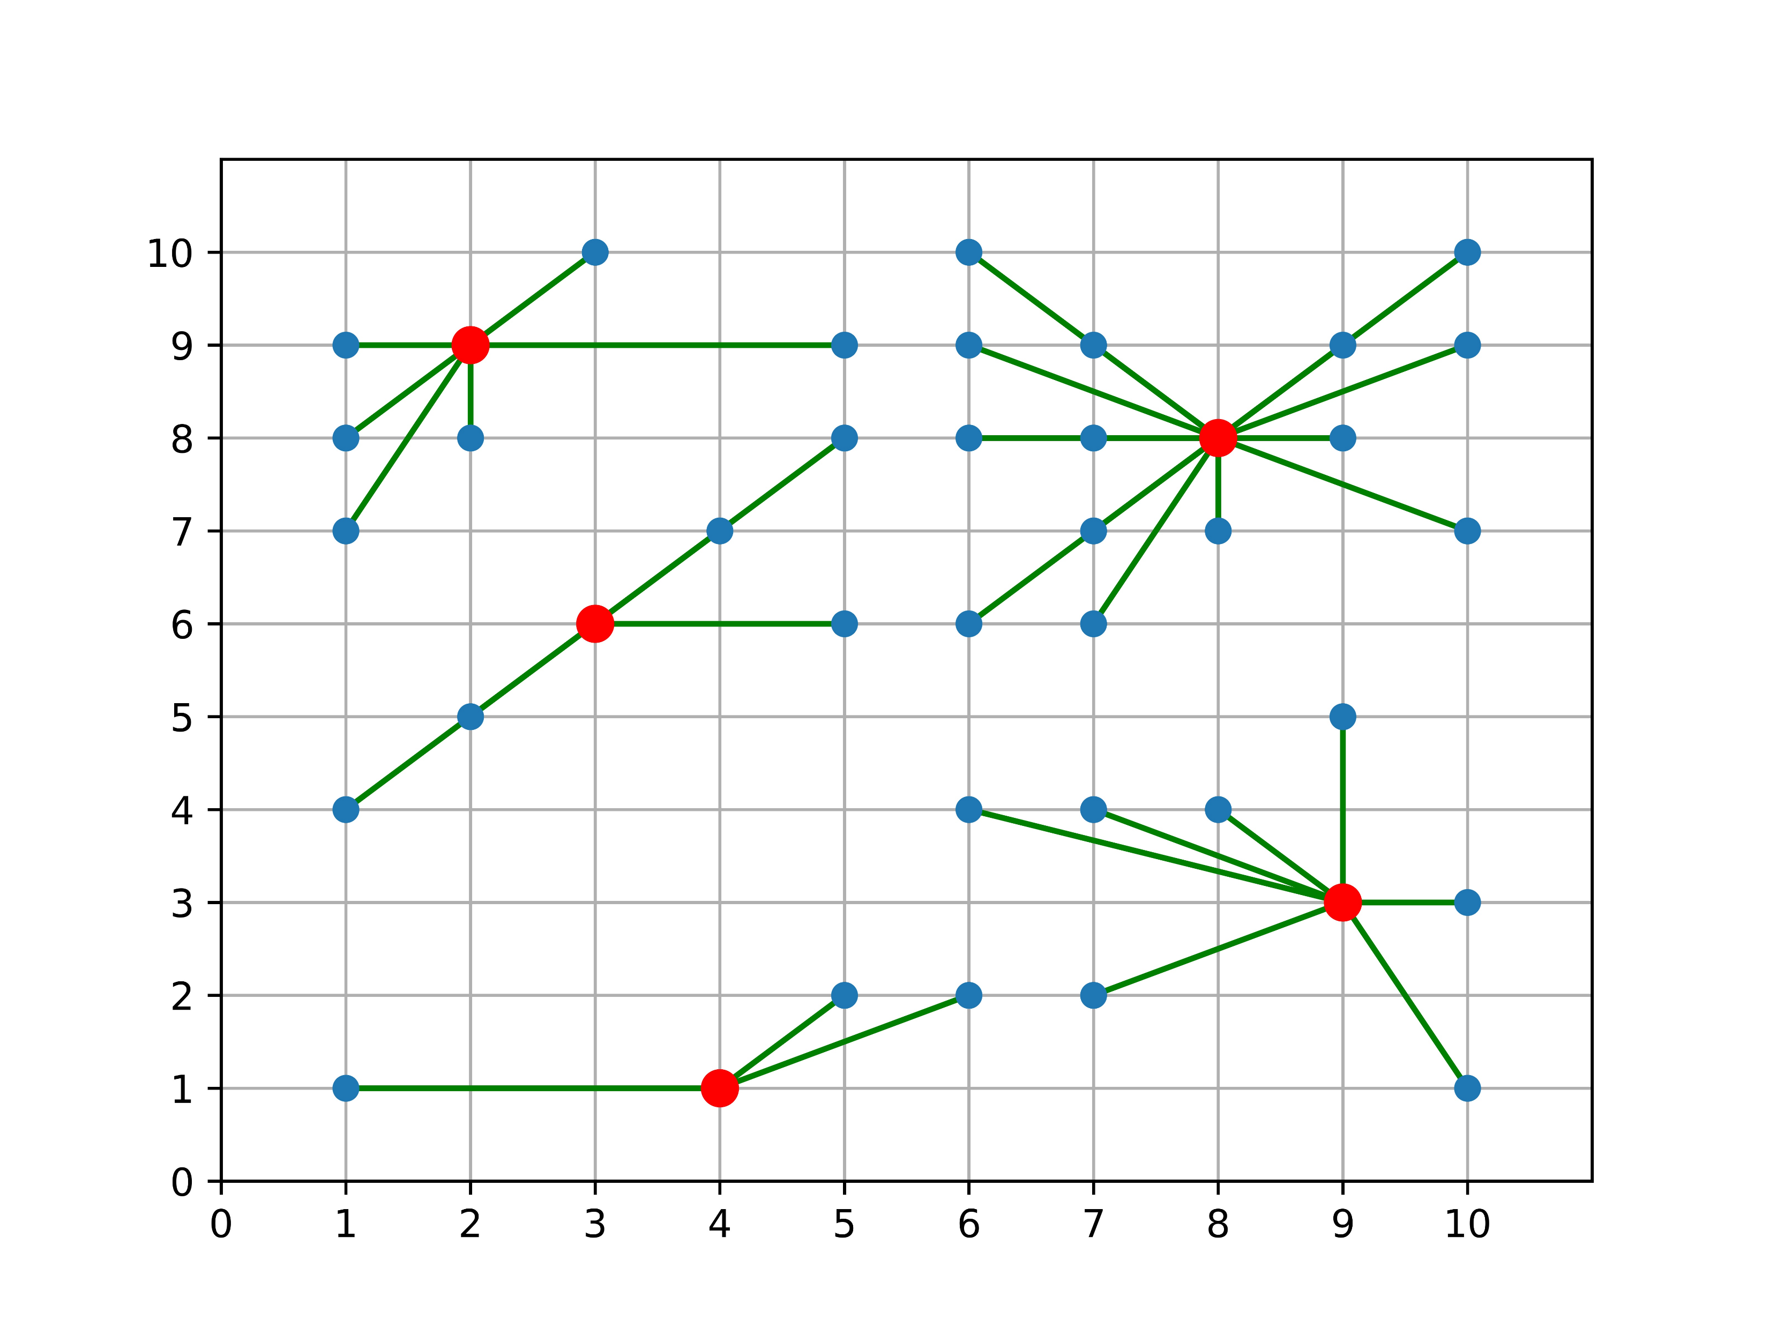
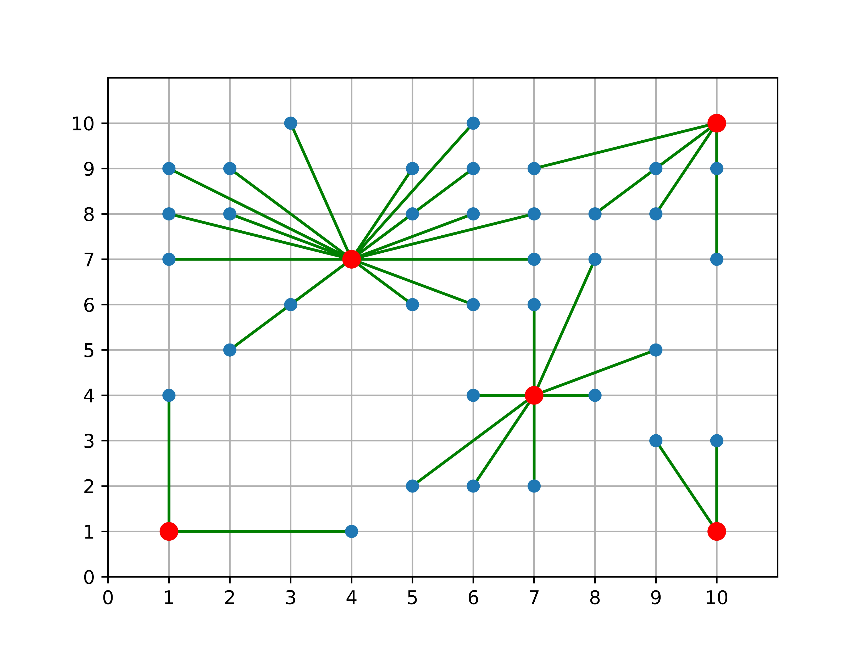
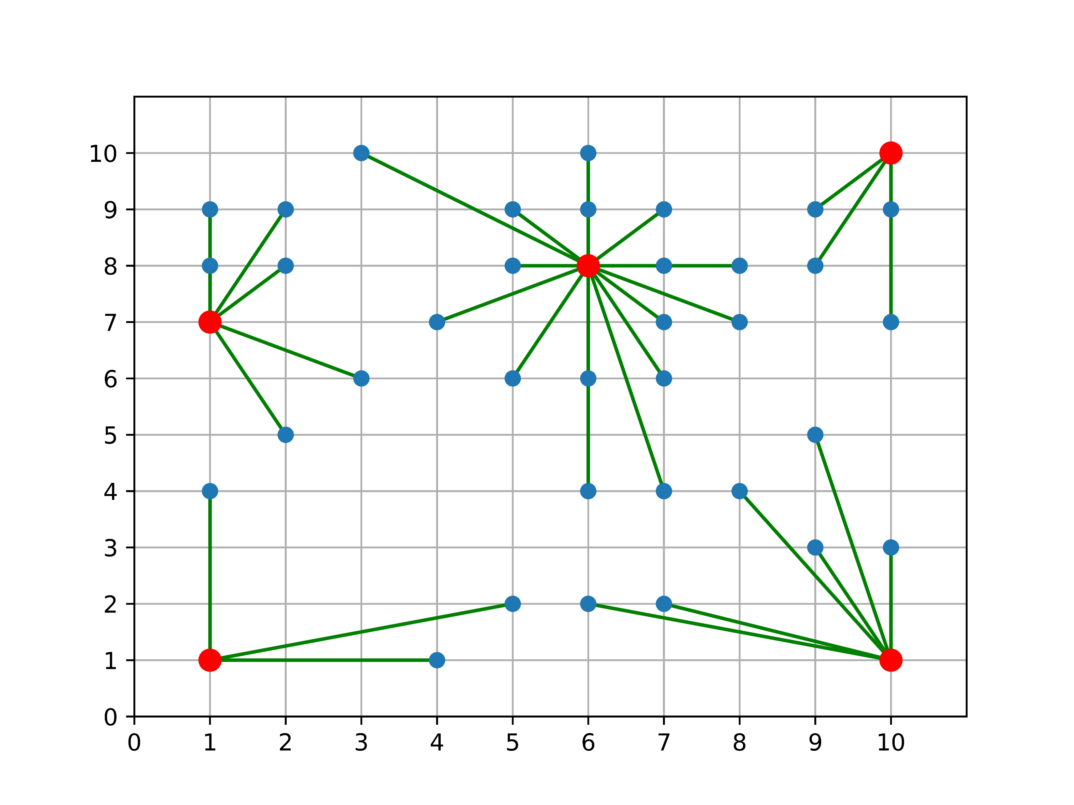
The algorithm to select the initial center for the greedy center selection
Global Optimal
Greedy Optimal
Quality is 1.14
Greedy from the site I choice
Quality is 1.30
There are 40 sites in the map, and the num of center is 5

Slide 9
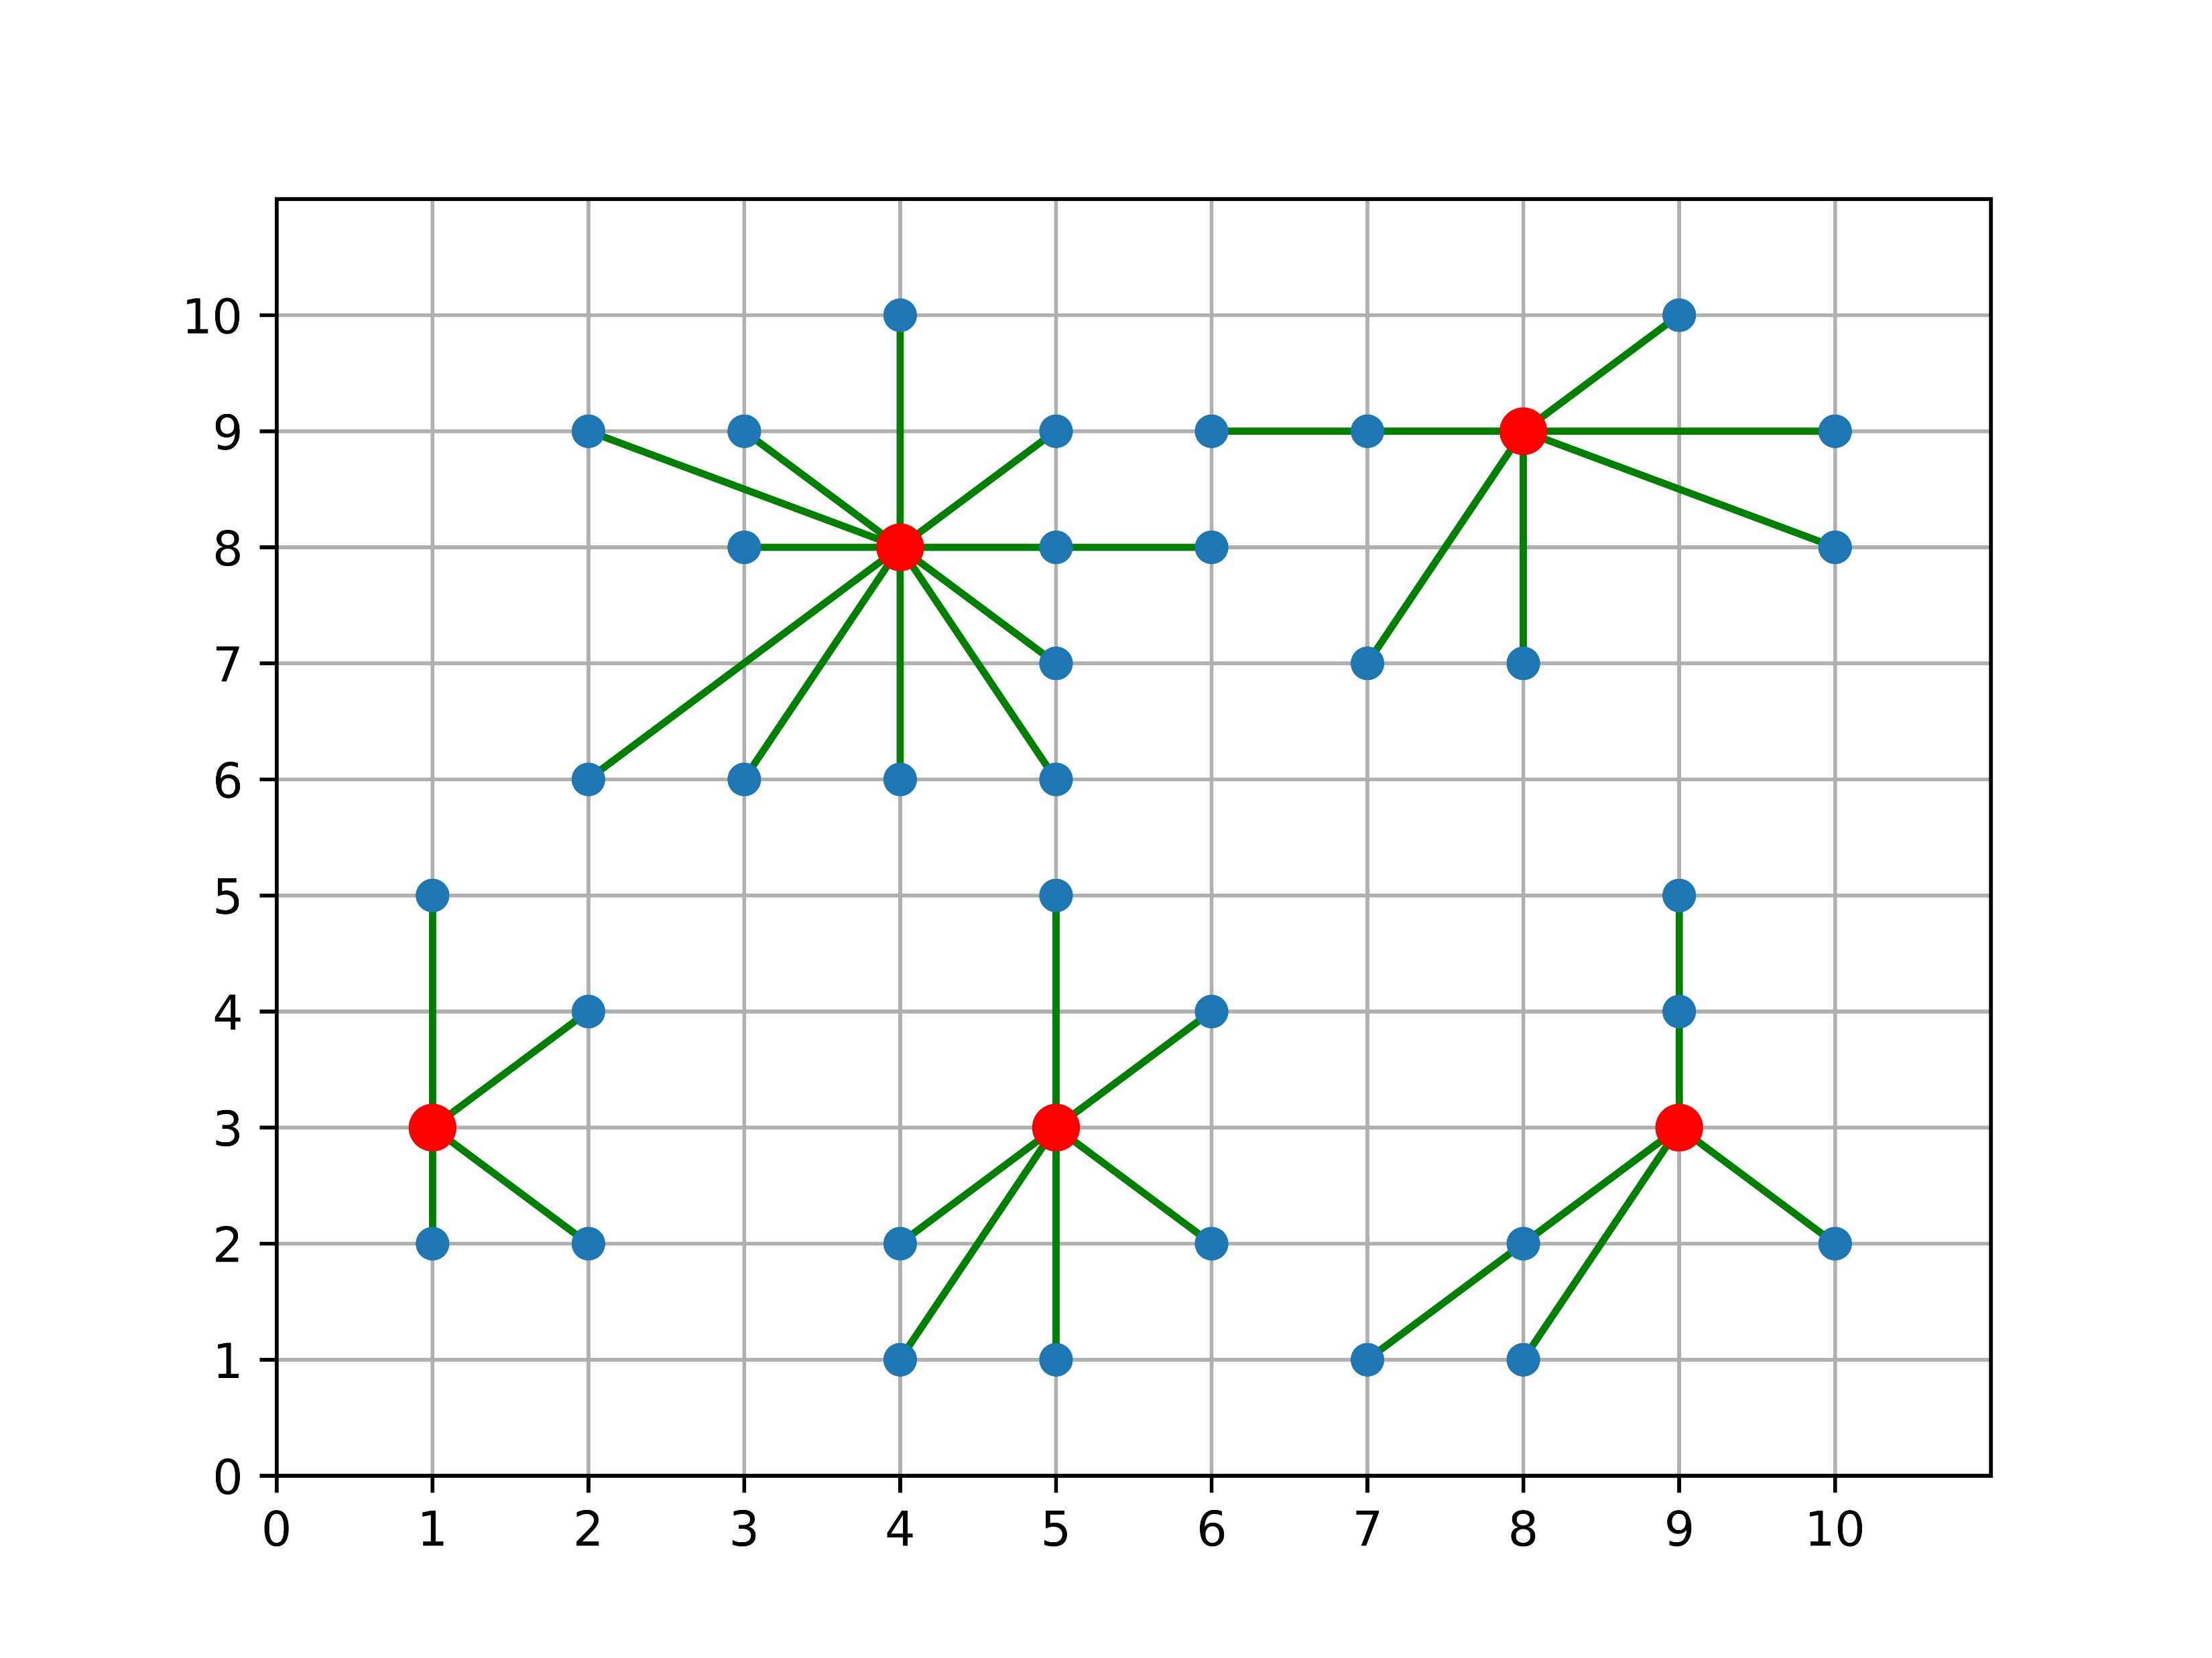
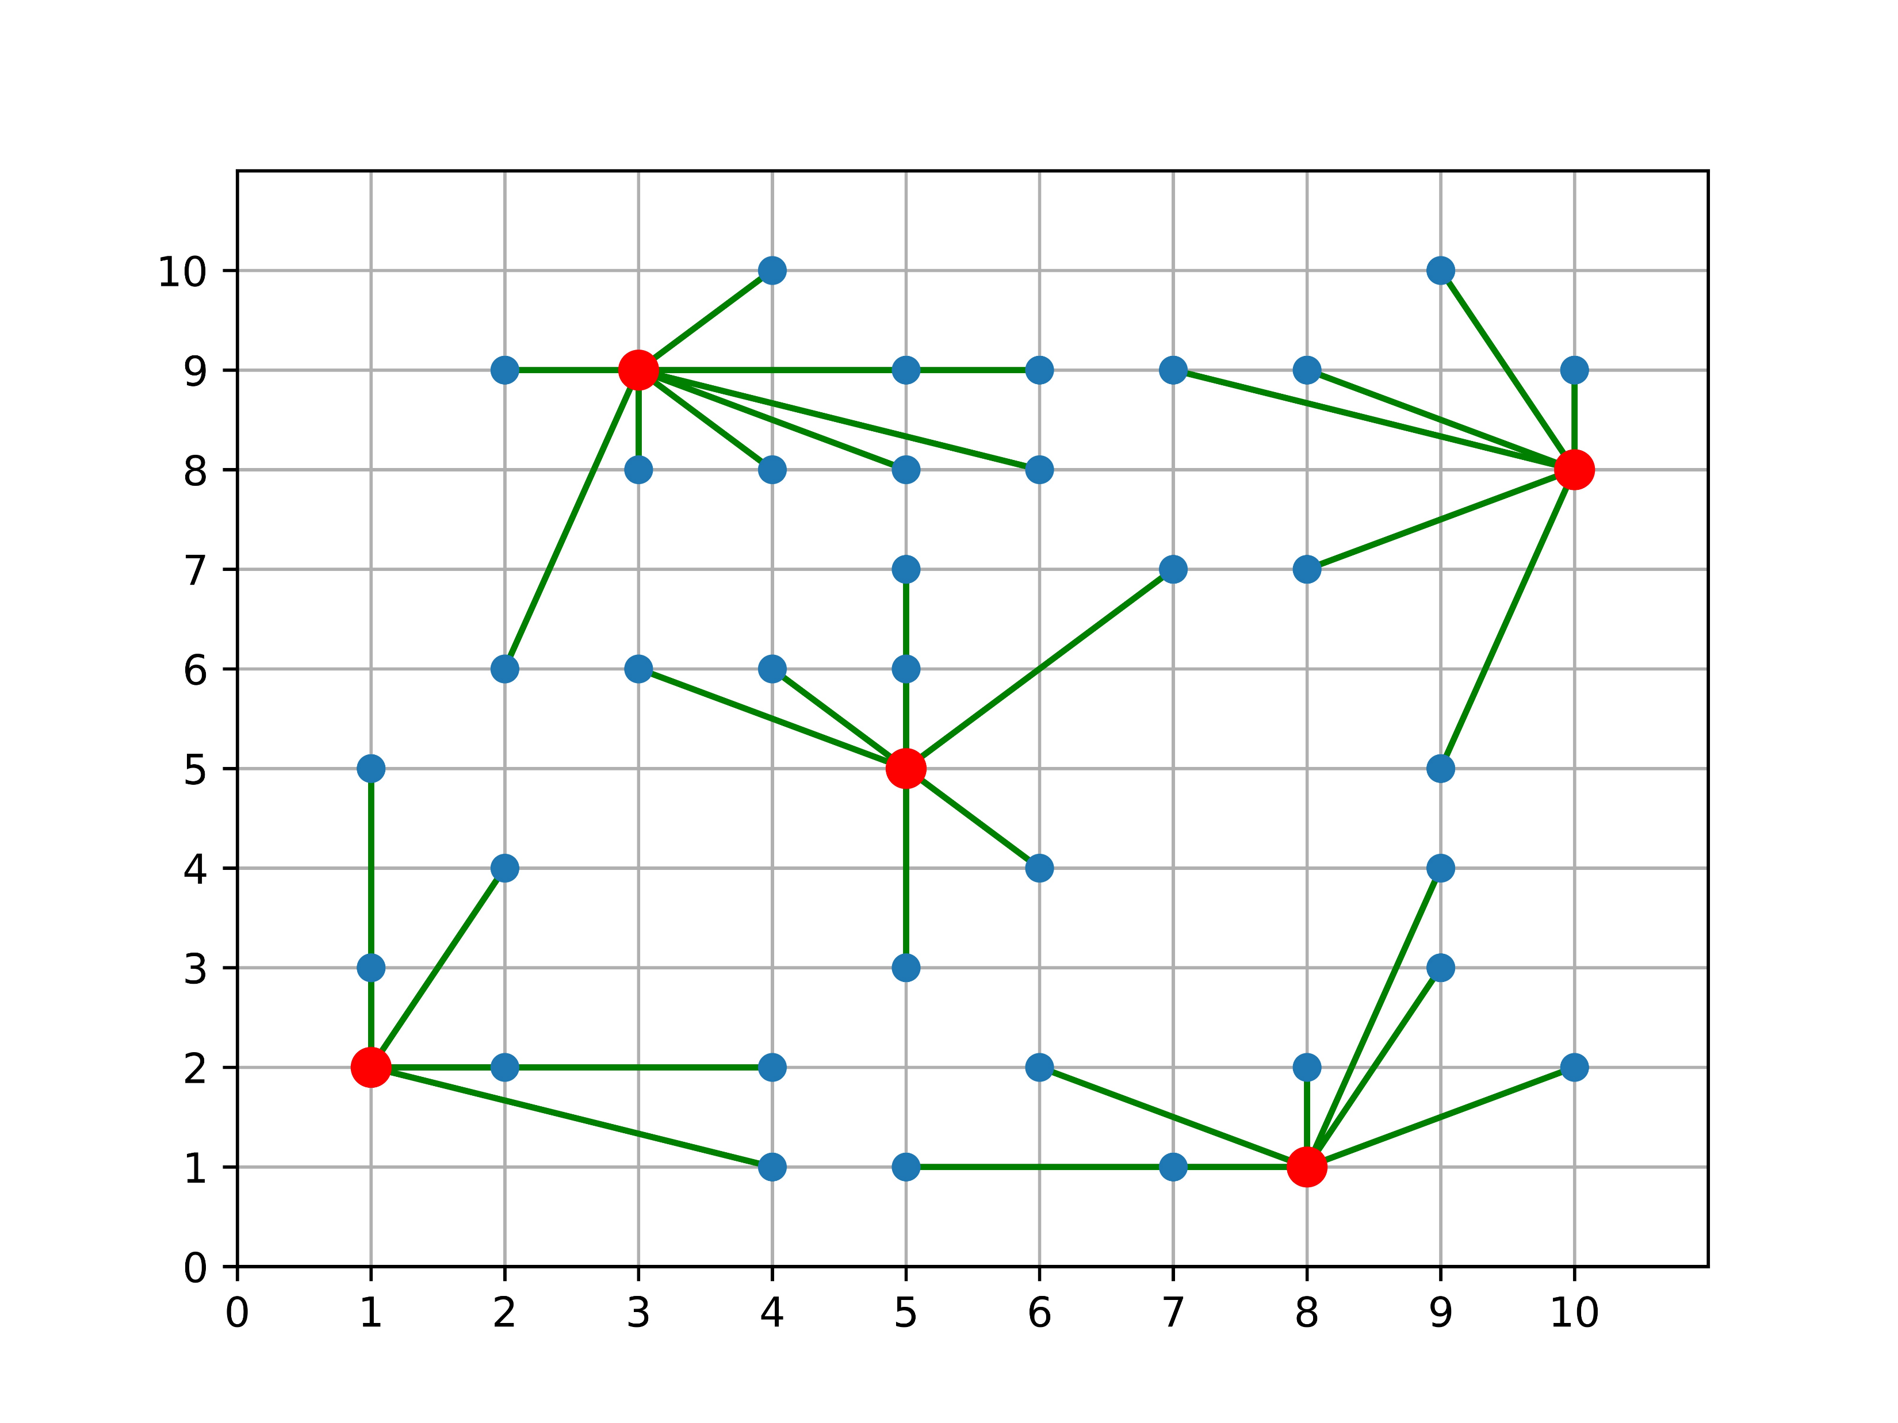
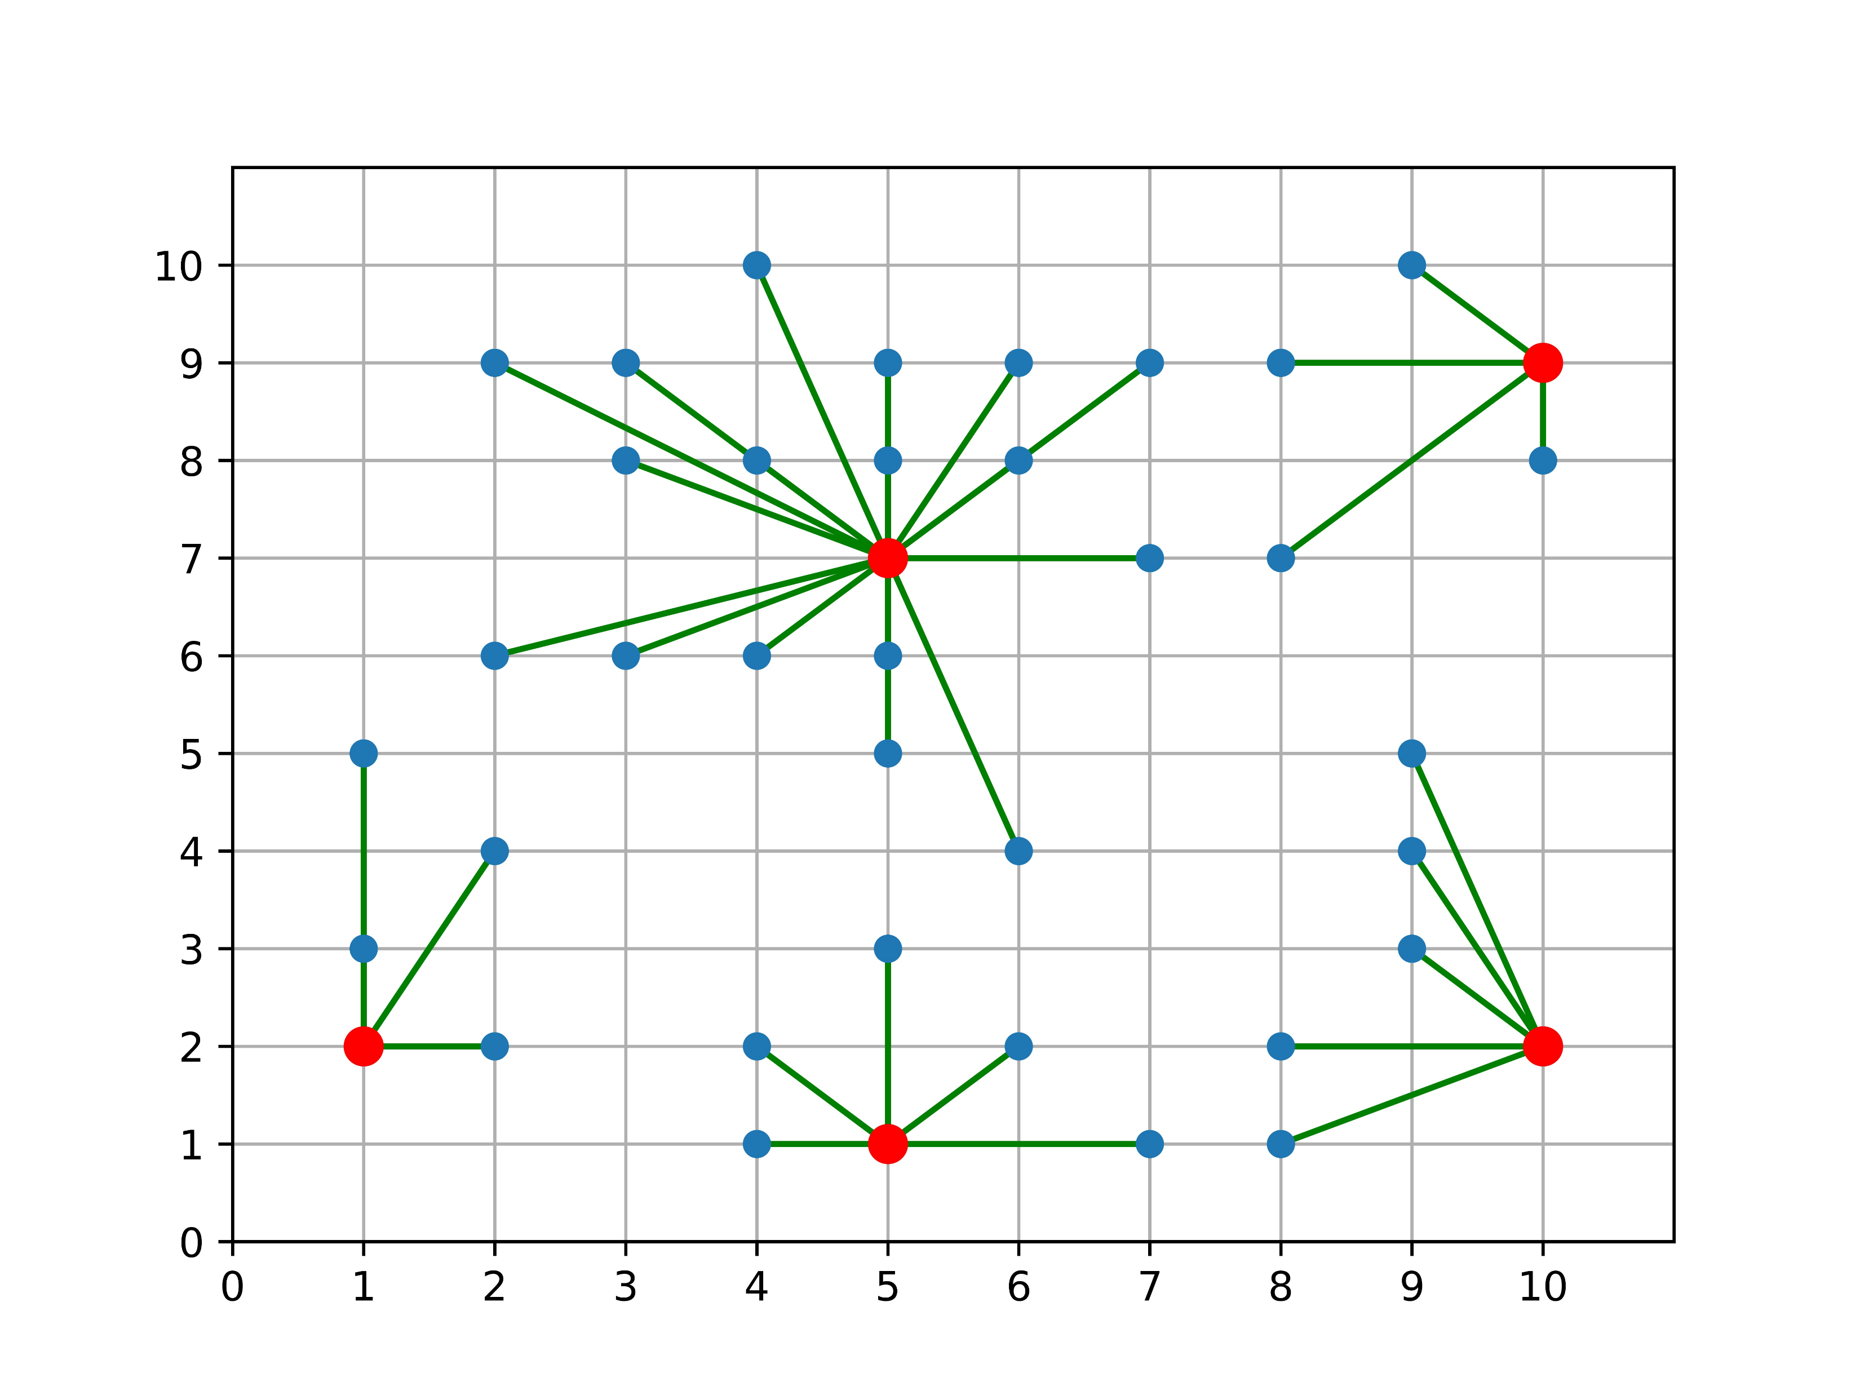
The algorithm to select the initial center for the greedy center selection
Global Optimal
Greedy Optimal
Quality is 1.12
Greedy from the site I choice
Quality is 1.27
There are 40 sites in the map, and the num of center is 5

Slide 10
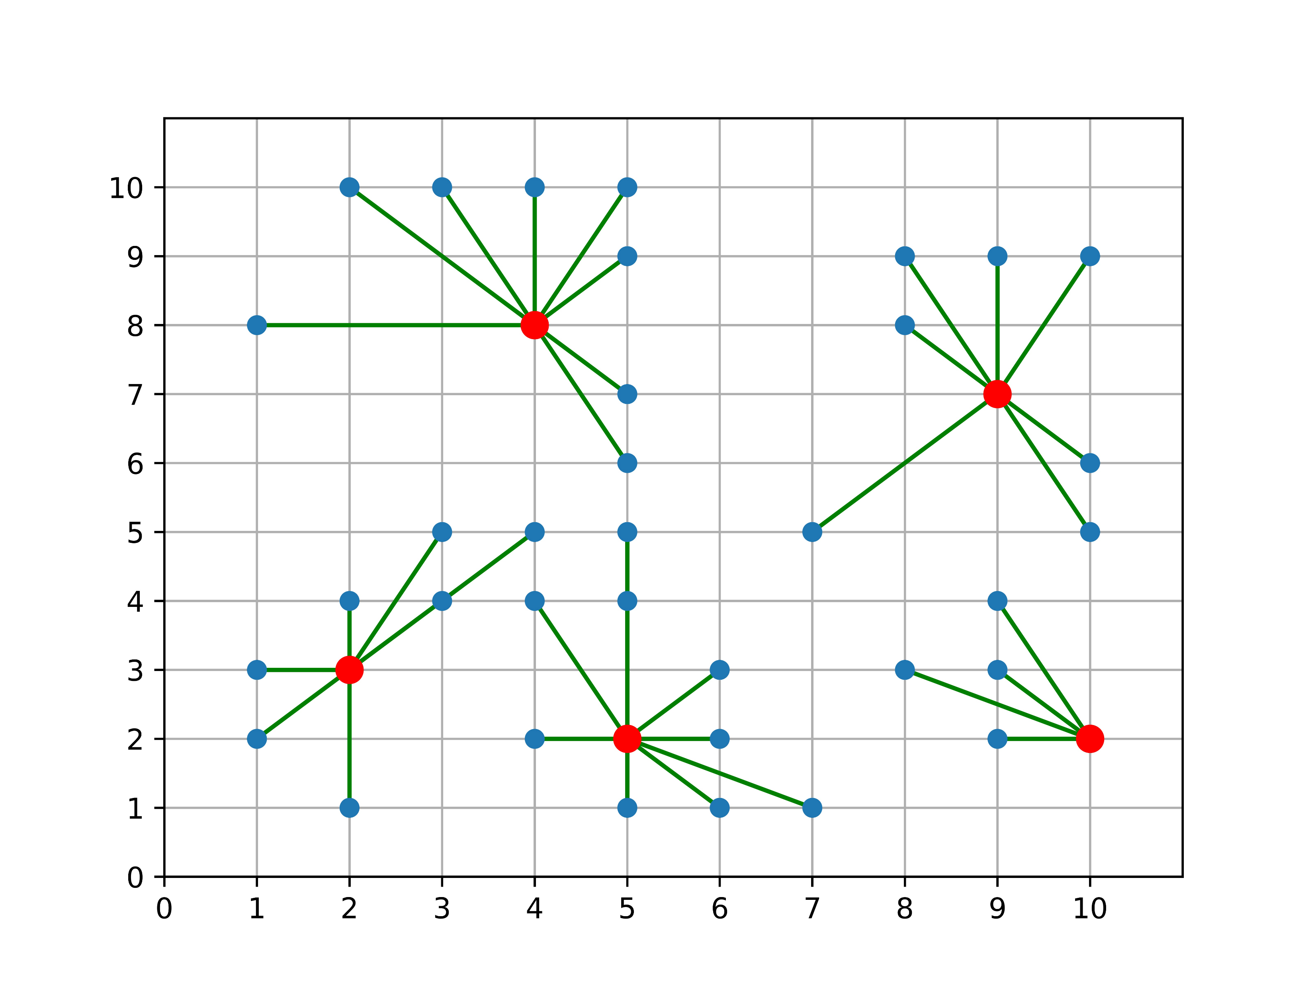
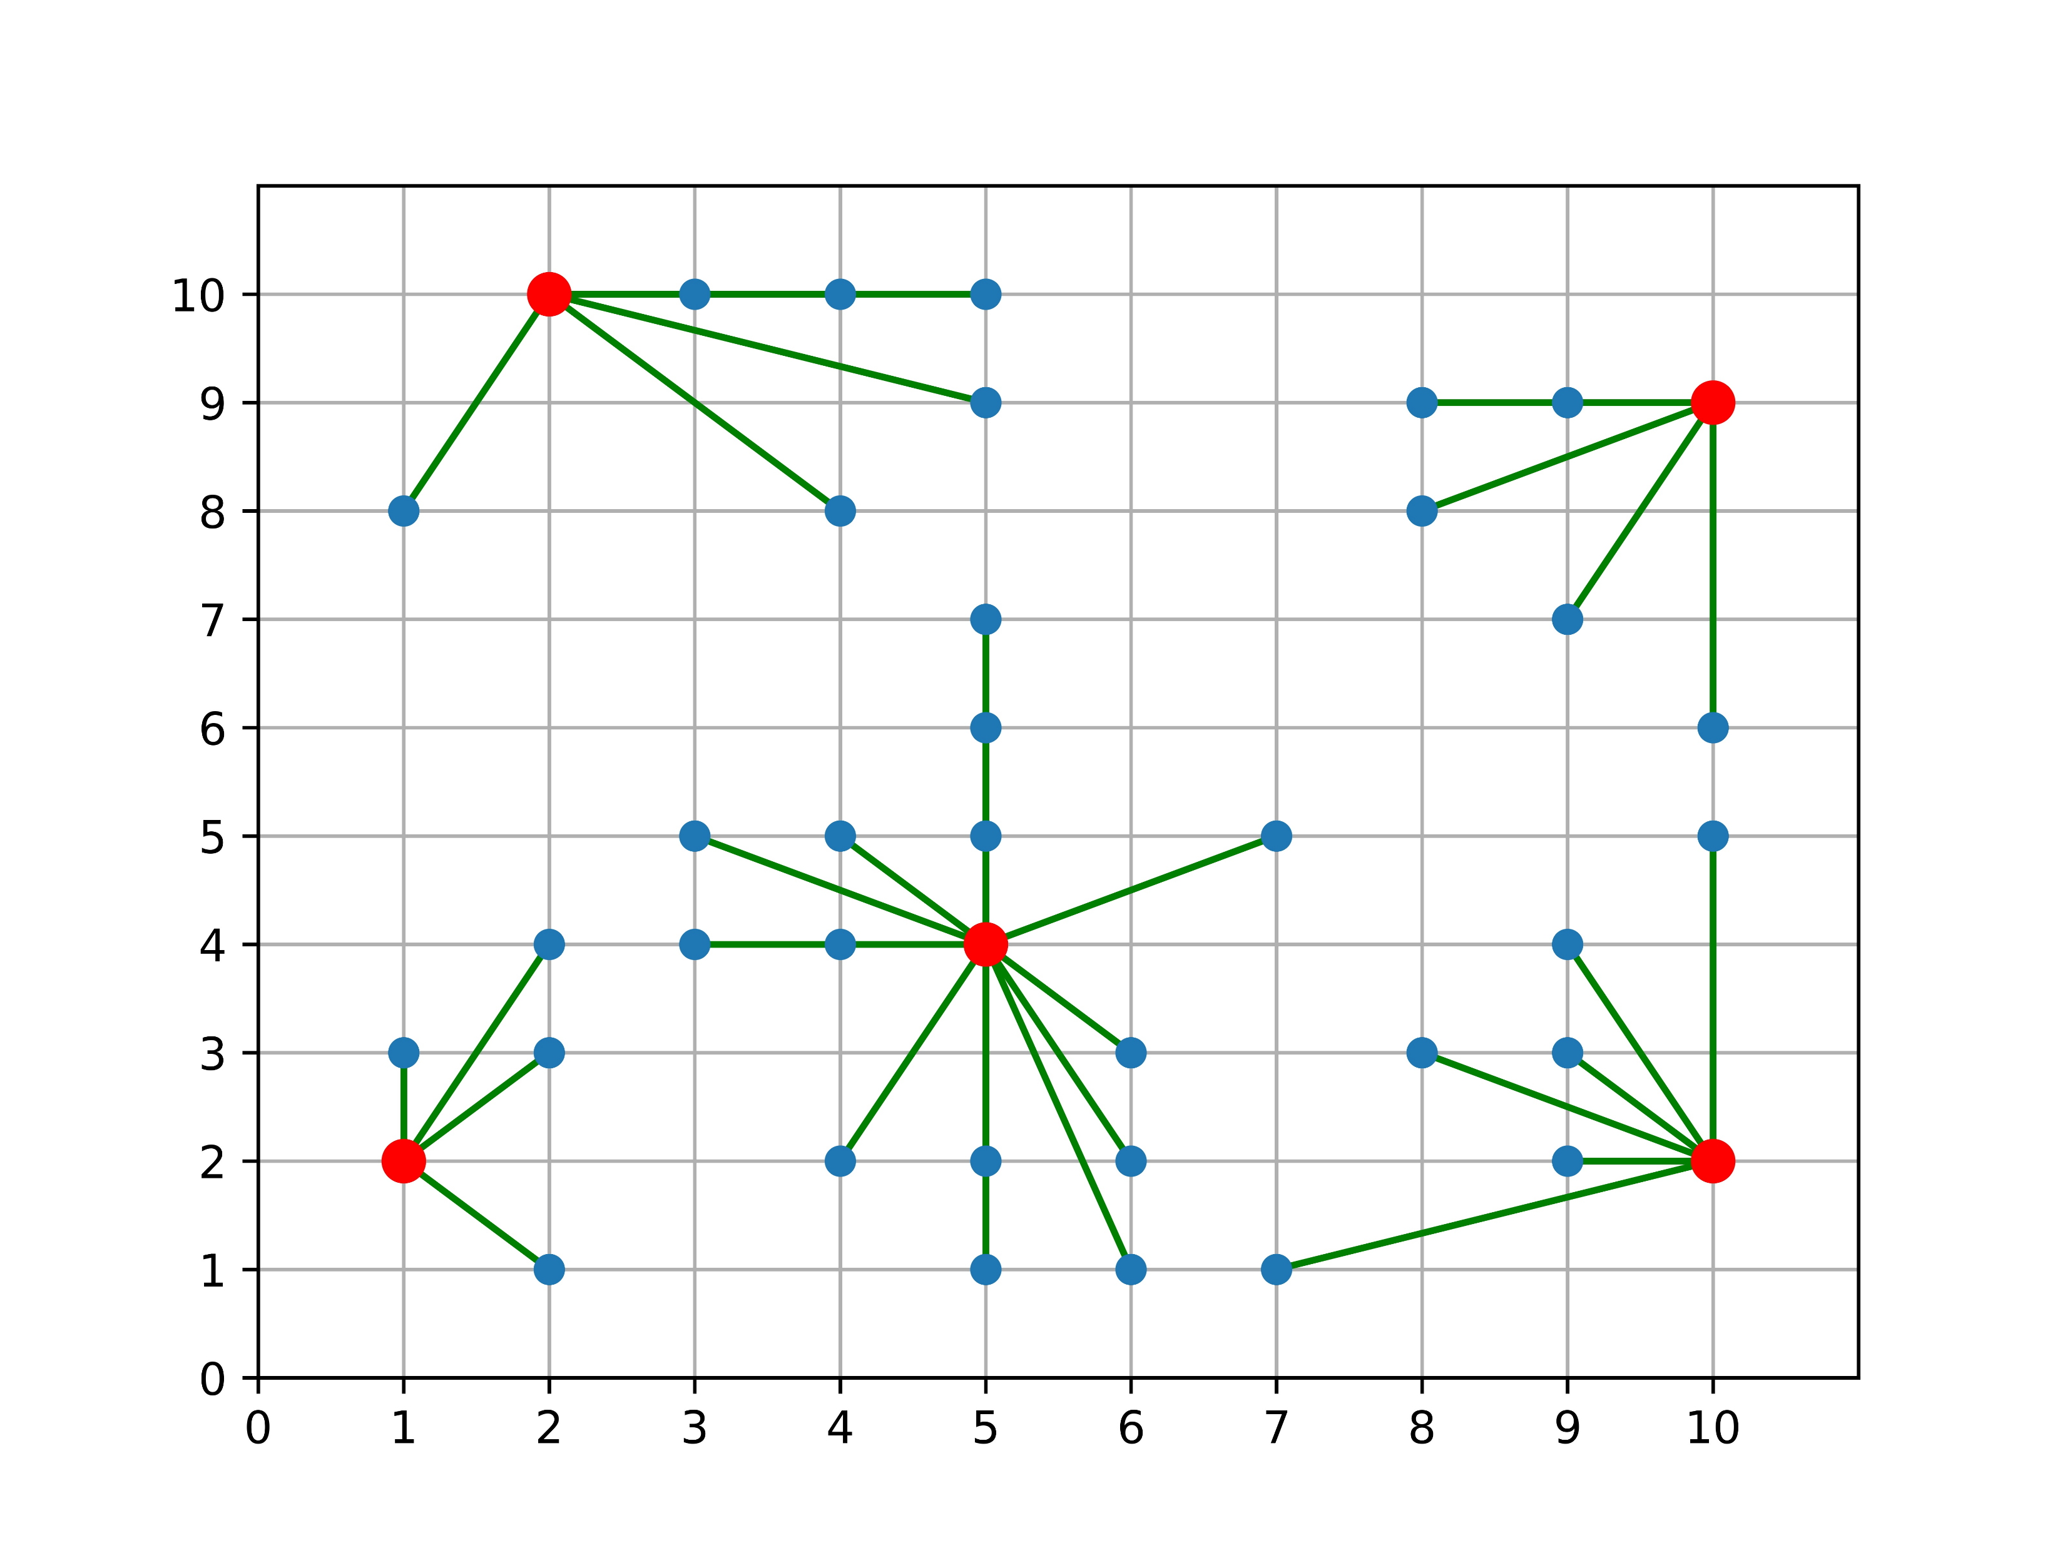
The algorithm to select the initial center for the greedy center selection
Global Optimal
Greedy Optimal
Quality is 1.05
Greedy from the site I choice
Quality is 1.05
There are 40 sites in the map, and the num of center is 5

Slide 11
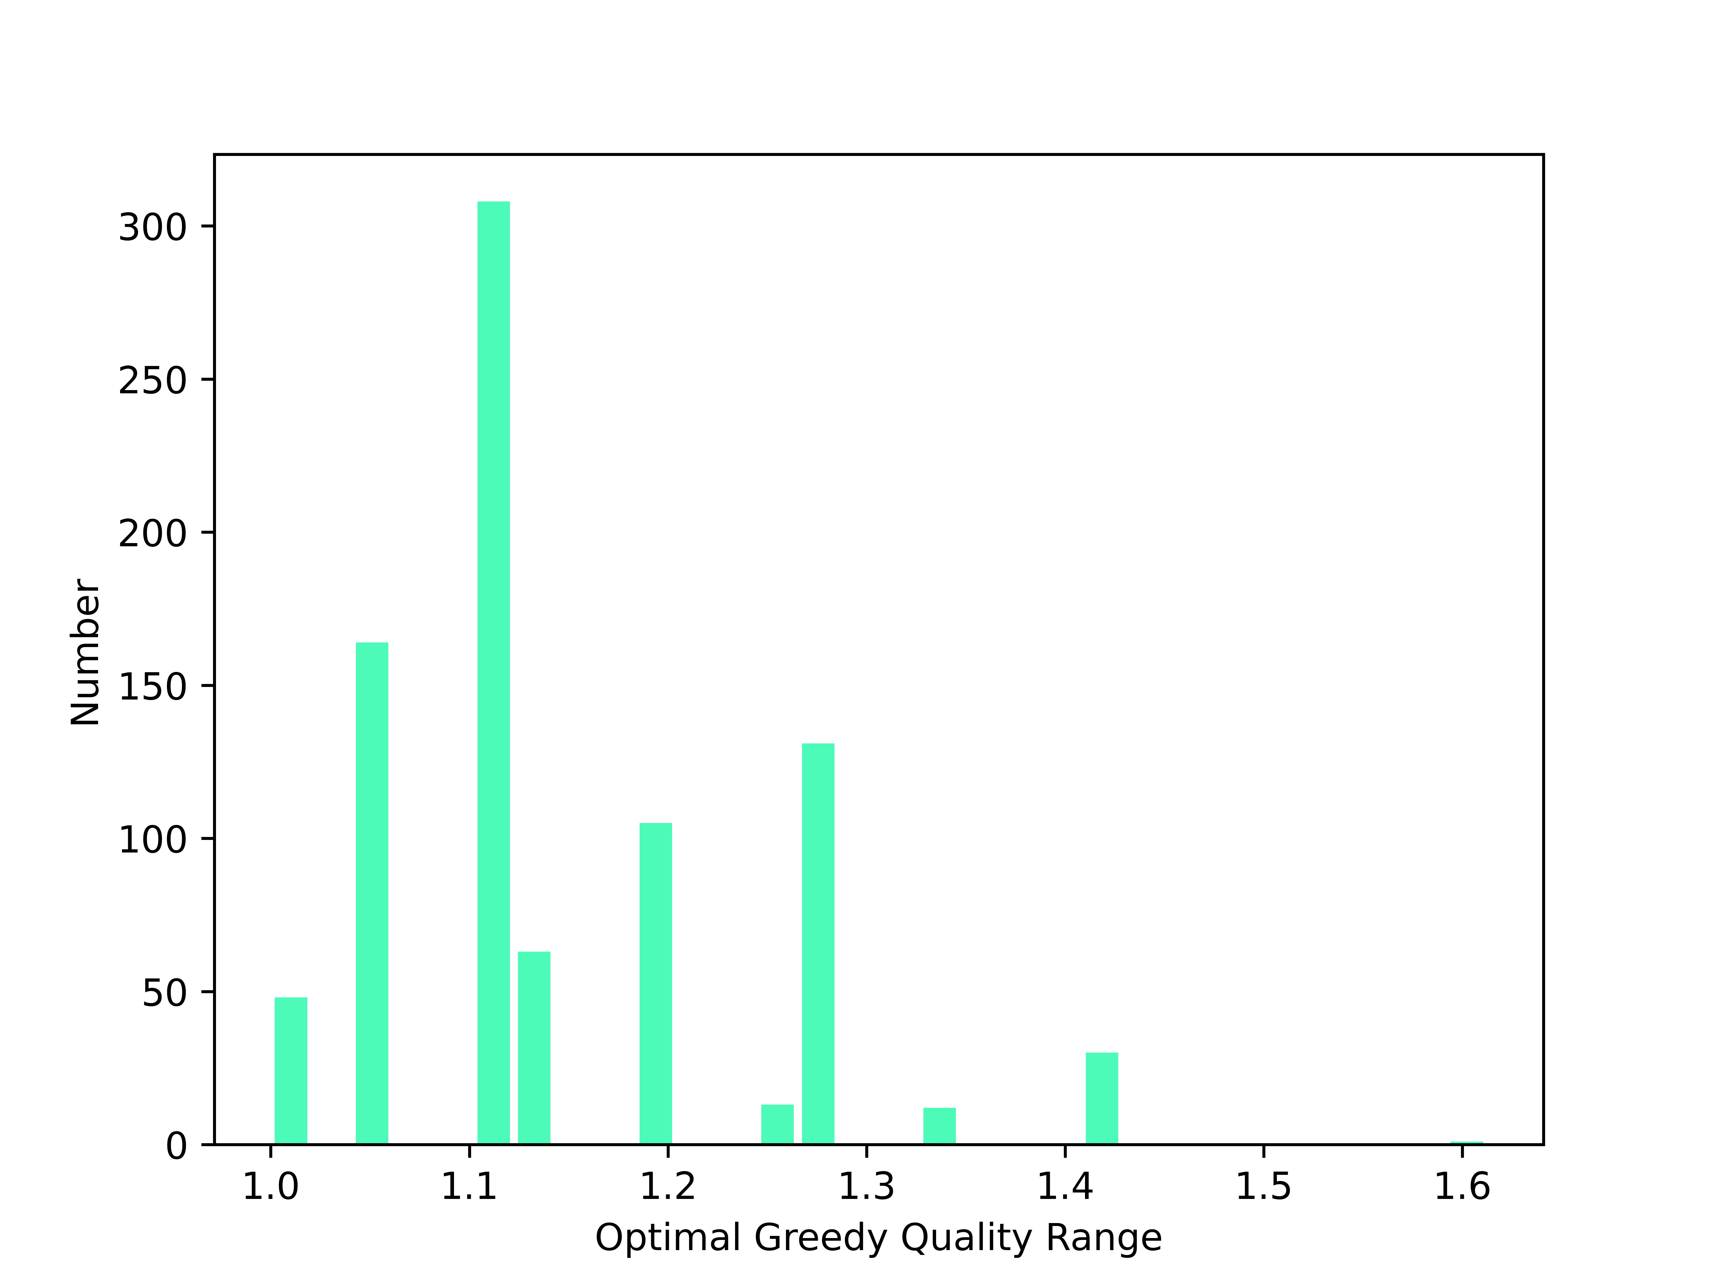
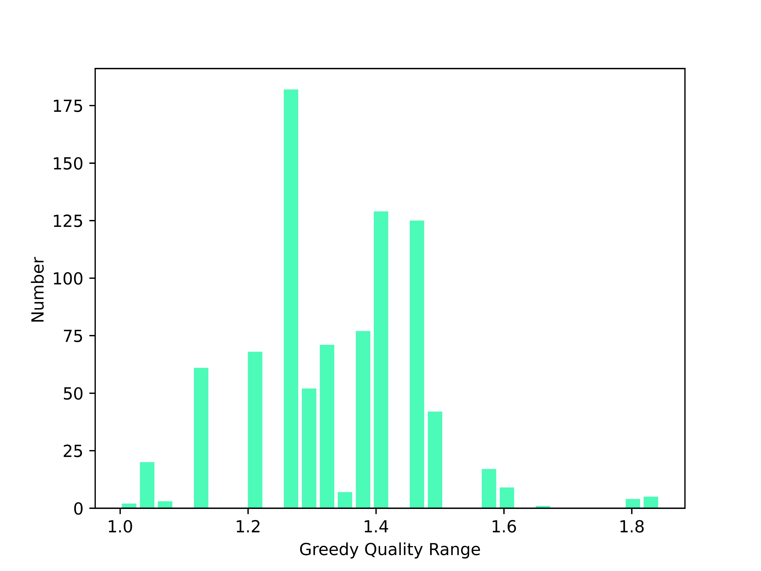
The algorithm to select the initial center for the greedy center selection
Statistic 875 samples and get the result.
Traverse all the site as the start center and get the best one
Use the algorithm to get the start center

Slide 12
Thank You !
Q&A

